Slide 1
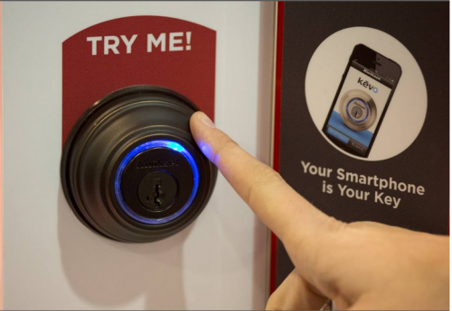
Smart Locks- Amazon Product Analysis
Title: Smart Locks Market Analysis
Subtitle: Insights from Amazon Data
Name: Chaitanya Sharma
Date: 5th Sept, 2024
ThePhoto by PhotoAuthor is licensed under CCYYSA.

Slide 2
Project Overview
Objective: Analyze key players in the smart locks market using scraped data from Amazon
Scope
Scraping data
Analyzing data
Presenting findings

Slide 3
Tools & Technologies
Web Scraping
Python
SQL
Excel
Power BI
PowerPoint

Slide 4

Data Collection
Data Fields:
Brand Name (str)
Price (int)
Rating (float)
Rating Count (int)
Review Count (int)
Ranking (int)
URL (str)

Slide 5

Data Analysis
Total Distinct Brands: 52
ThePhoto by PhotoAuthor is licensed under CCYYSA.

Slide 6

Top Brands by SKU Count
Brands with Highest SKU Counts
Smart: 38 SKUs
Keyless: 26 SKUs
Veise: 25 SKUs
Yale: 15 SKUs
Kwikset: 14 SKUs
ThePhoto by PhotoAuthor is licensed under CCYYSA.

Slide 7
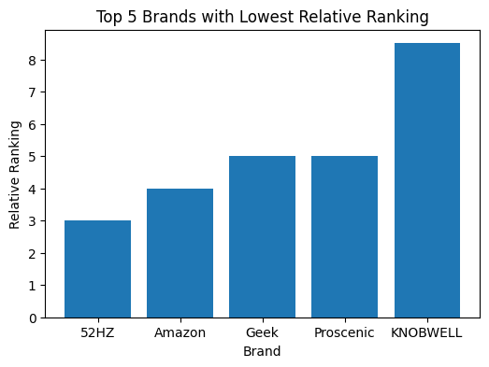
Top Brands with Lowest Relative Ranking
Top 5 Brands
52hz: 3.0
Amazon: 4.0
Geek: 5.0
Proscenic: 5.0
Knobwell: 8.5

Slide 8
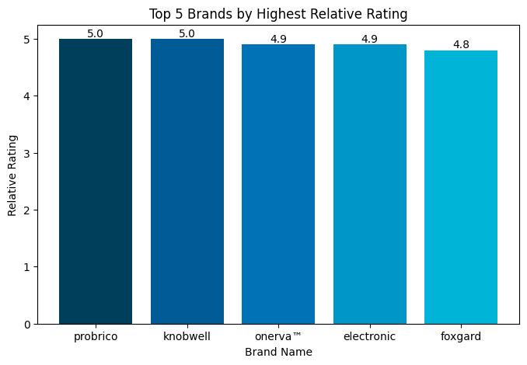
Highest Relative Ratings
Top Rated Brands
Probrico: 5.0
Knobwell: 5.0
Onerva™: 4.9
Electronic: 4.9
Foxgard: 4.8

Slide 9
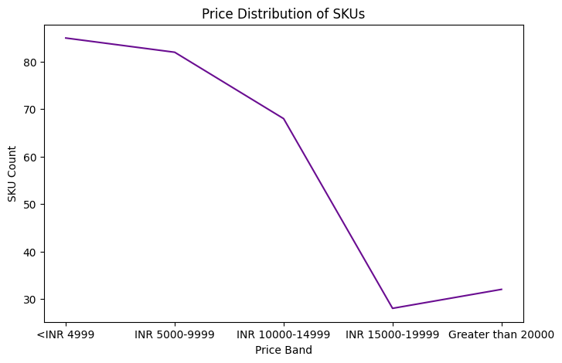
Price Distribution of SKUs
Analysis of SKUs across different price bands:

Slide 10
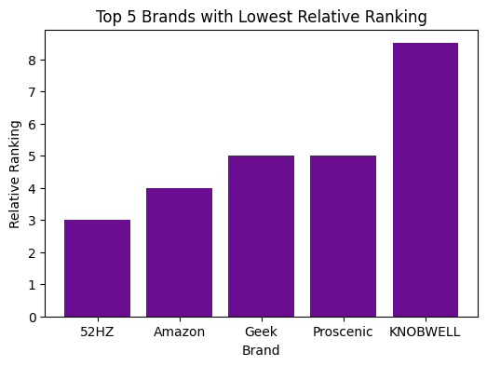
Key Insights
Most Popular Brands: KNOBWELL, Proscenic, Geek, Amazon, 52HZ
Correlation: Brands with the lowest relative ranking are more popular on Amazon.

Slide 11
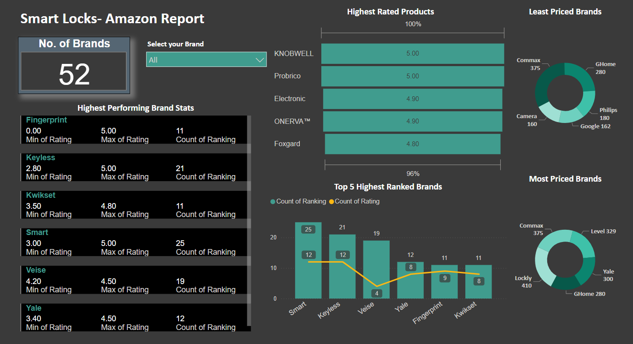
Dashboard & Visualization

Slide 12

Conclusion & Recommendations
Summary:
1. Top Performing Brands:
Probrico, Knobwell, Onerva™, Electronic, and Foxgard have the highest relative ratings, indicating that they deliver superior quality and customer satisfaction consistently.
2. Brands with Highest SKU Counts:
Smart (38 SKUs), Keyless (26 SKUs), Veise (25 SKUs) are the top brands with the highest number of SKUs. This suggests these brands offer a diverse range of products to cater to various customer preferences and needs.
3. Price Distribution:
The distribution of SKUs across different price bands highlights a significant market presence for brands at various price points, enabling them to target different segments effectively.
ThePhoto by PhotoAuthor is licensed under CCYYSA.

Slide 13

Q&A
Feel free to ask questions!

